Slide 1
Model-Car Database Analysis with My SQL Workbench

Slide 2

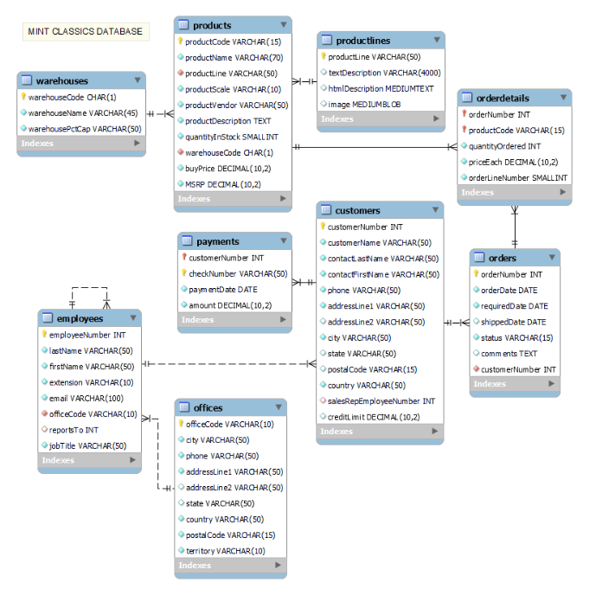
Building up the database, get familiar with the data and datamodel (EER diagram)
Business Issue relates to the dashed data Tables
For this analyses Payments, customer details such as address and phone number, officces and employes has been considered as less relevant factors

Slide 3









Overall, less ordered sub-categories are placed in the highest capacity storage
South Warehouse has the biggest capacity
Ships, Trains, Trucks & Buses are strored in biggest warehouse
Classic Cares are adding the most, whilst Ships and Trains the less value

Slide 4
Biggest capacity warehouse has the lowest efficiency rate
South Warehouse has the lowest efficiency
Reccommendations
Overall Insight:
Might worth consider to improve efficiency across all warehouses
→ on – time delivery rate is low in all storages
Reorganization:
Option 1: reorganise and close South storage as it has the lowest efficiency. Low ordered sub-categories in-stock (Trains, Ships) can be reduced
Option 2: reorganise and close West storage as it has the lowest capacity. Second most ordered vintage cars can be distribute across storages especially in the most efficient warehouse (North)

